Slide 1
To explore new shopping complex oppurtunities in KUALA LUMPUR , MALAYSIA
BY:
VIPUL THAKUR

Slide 2
BUSINESS PROBLEM
TO ANALYSE DIFFERENT AREAS WHICH COULD BE SUITABLE FOR SETTING UP TOURIST DESTINATIONS .
TARGET IS MAINLY TOURIST COMMUNITY

Slide 3
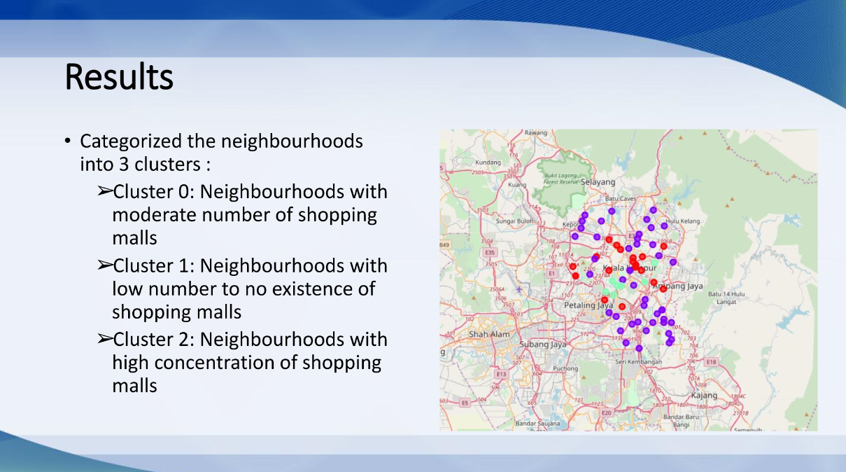

Slide 4
RECOMMENDATION
OPEN THE SHOPPING MALL IN CLUSTER 1 , IT HAS NO COMPETITION .
CLUSTER 0 HAS LESS COMPETITION OR MODERATE COMPETITION .

